Slide 1
FACE AUTHENTICATION USING DEEP LEARNING ON WEB BASED

Slide 2

ITA6099 - Masters Thesis
Reg. No: 19MCA0044
Student Name: DINESH M
Guide Name: Dr. ANNY LEEMA A

Slide 3
Abstract
The human face is an important biometric quantity which can be used to access a user-based system. As human face images can easily be obtained via web cameras this Method generally apply a series of processes against the input image in order to detect the liveness of the face. Deep-learning-based spoof face detection is proposed to identity and detect the liveness of the input face. A secure system needs Liveness detection in order to guard against such spoofing. In this work, face liveness detection approaches are categorized based on the various types of techniques used for liveness detection. This categorization helps to understand different spoof attack scenarios and their relation to the developed solutions

Slide 4
Introduction:
Face recognition plays a critical role in the authentication of users and is essential for many user-based systems. The past decade has seen the rapid development of face recognition in many fields This project is about adding the security to login into the website. Which is added to an additional way of login and it will reduce the time for the normal way of login If we login to the site the message about the login notification send to their user mobile.

Slide 5
Literature Survey
AUTOMATIC ATTENDANCE MANAGEMENT SYSTEM USING FACE DETECTION
AUTHOR: E.Varadharajan,R.Dharani, S.Jeevitha, B.Kavinmathi, S.Hemalatha
This paper is about the biometric attendance management. it will capture the image, the faces are detected and then it is recognized with the database and finally the attendance is marked.
The Eigen face is the one of the method. Eigen faces is set of Eigen vectors which are used in computer vision problem of face recognition.

Slide 6
[2]
2D and 3D FACE RECOGNITION BASED ON IPC DETECTION AND PATCH OF INTEREST REGIONS
AUTHOR: Mebarka BELAHCENE, Ammar CHOUCHANE, Nadia MOKHTARI
The role of important patches of face: nose and eyes is investigated in this work. An efficient method based on PCA (Principal component analysis) followed by EFM (Enhanced Fisher Model) is used to build the characteristic features, these latter are sent to the classification step using two methods, Distance Measurements and SVM (Support Vector Machine).

Slide 7
[3]
Actualization of Face Detection in FPGA using Neural Network
AUTHOR: Syed Ameer Abbas, G. Vicithra
The main goal of the work is to identity the face from a given database images. The face images have similar geometrical features and hence discriminating one face from the other in the database is achallenging task. The implementation of Crude method and Viola Jones algorithm is taken for features extraction.

Slide 8
[4]
CORRELATION-BASED FACE DETECTION FOR RECOGNIZING FACES IN VIDEOS
AUTHOR: Heng-Wei Hsu1 , Tung-Yu Wu , Wing Hung Wong and Chen-Yi Lee
In this paper, we propose a correlation-based face detection approach to improve the performance of face recognition tasks for videos. We apply correlation measures to pairs of response maps which are generated from automatically selected neurons in deep convolutional neural network (CNN) models to detect faces in each video frame. The embeddings extracted from faces cropped by our proposed approach are more consistent across each video sequence and more suitable for face recognition and clustering tasks

Slide 9
[5]
Design of Face Detection and Recognition System for Smart Home Security Application
AUTHOR: Dwi Ana Ratna Wati, Dika Abadianto
The design is implemented using MyRIO 1900 and programmed using LabVIEW. The connection between myRIO and computer is wifi network. The image of a person is acquired via webcam connected to MyRIO using USB cable.
to examine the performance of the face detection in various change of distance, light intensity, light position angles, person’s accessories and shirt colour. The face detection modul has good performance in some conditions as distance between the person and the camera is less than 240 cm

Slide 10
[6]
Face detection and recognition application for Android
AUTHOR: Monica Chillaron, Larisa Dunai, Guillermo Peris Fajarnes, Ismael Lengua Lengua
development of a face detection and recognition application developed into Raspberry Pi and Android. The application connects with the Raspberry Pi by Bluetooth protocolsThe object detection is based on boosted cascade while the face recognition is based on Eigenfaces

Slide 11
[7]
Face Detection and Recognition Method Based on Skin Color and Depth Information
AUTHOR: Junfeng QianˈShiwei MaˈZhonghua HaoˈYujie Shen
An improved face detection and recognition method based on information of skin color and depth obtained by binocular vision system was proposed in this paper. With this method, the face area was detected firstly by using Adaboost algorithm. Afterwards, the real face was distinguished from fake one by using the skin color information and the depth data.

Slide 12
[8]
Matlab Simulation of Algorithms for Face Detection in Video Surveillanc
AUTHOR: Cristian sanchez, Diana Martinez-Mosquera, Rosa Navarrete
facial detection, there are a series of algorithms that allow the face to be extracted in a video image, among which are the Viola & Jones waterfall method and the method by geometric models using the Hausdorff distance. In this article, both algorithms are theoretically analyzed and the best one is determined by efficiency and resource optimization.
The images obtained, using a digital camera in the 13 scenarios, have been analyzed using Matlab code of the Viola & Jones and Viola & Jones algorithm combined with the Kanade-Lucas-Tomasi algorithm to add the feature of completing the tracking of a single object.

Slide 13
[9]
People Count Estimation Using Hybrid Face Detection Method
AUTHOR: Neethu A, Athi Narayanan S, Kamal Bijlani
Face detection techniques are widely used to count the presence of people in an image. In this paper we present a hybrid face detection method for people count by combining three efficient face detection methods - Normalized Pixel Difference (NPD) , haar classifier and haar classifier for profile face. NPD is a scale invariant method and its performance is good in difficult backgrounds and low illuminations. A combination of these three face detectors are used in order to improve the accuracy and to reduce false detections.

Slide 14
[10]
Spoofing Face Detection based on Spatial and Temporal Features Analysis
AUTHOR: Chin-Lun Lai , Jun-Horng Chen, Jing-Ying Hsu, Chih-Hong Chu
proposed to increase the reliability of face recognition systems. Via the simple spatial-temporal spectral analysis and border edge detection, people with fake face as the recognition system input will be pick out efficiently and effectively. Experimental results show that the proposed method is competitive and practical to be implemented in the portable equipments with face recognition function

Slide 15
Liveness detection
liveness detector capable of spotting fake faces and performing anti-face spoofing in face recognition systems.
SSD Mobilenet V1
Single Shot Multibox Detector based on MobileNetV1. The neural net will compute the locations of each face in an image and will return the bounding boxes together with it's probability for each face.
68 Point Face Landmark Detection
After face detection, we can furthermore predict the facial landmarks implements a very lightweight and fast, yet accurate 68 point face landmark detector.

Slide 16
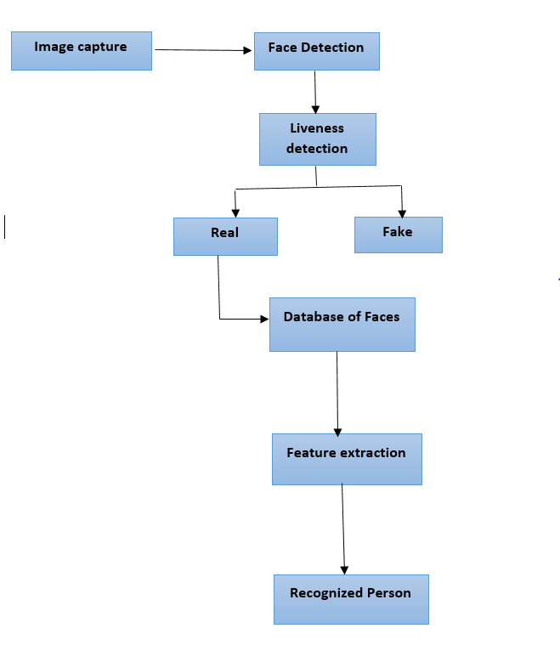
Flow Diagram

Slide 17
References:
[1] Varadharajan, E., et al. "Automatic attendance management system using face detection." 2016 Online International Conference on Green Engineering and Technologies (IC-GET). IEEE, 2016.
[2] Belahcene, Mebarka, Ammar Chouchane, and Nadia Mokhtari. "2D and 3D face recognition based on IPC detection and patch of interest regions." 2014 International Conference on Connected Vehicles and Expo (ICCVE). IEEE, 2014.
[3] Abbas, Syed Ameer, and G. Vicithra. "Actualization of face detection in FPGA using neural network." 2016 International Conference on Wireless Communications, Signal Processing and Networking (WiSPNET). IEEE, 2016.
[4] Hsu, Heng-Wei, et al. "Correlation-Based Face Detection for Recognizing Faces in Videos." 2018 IEEE International Conference on Acoustics, Speech and Signal Processing (ICASSP). IEEE, 2018.
[5] Wati, Dwi Ana Ratna, and Dika Abadianto. "Design of face detection and recognition system for smart home security application." 2017 2nd International conferences on Information Technology, Information Systems and Electrical Engineering (ICITISEE). IEEE, 2017.

Slide 18
References:
[6] Chillaron, Monica, et al. "Face detection and recognition application for Android." IECON 2015-41st Annual Conference of the IEEE Industrial Electronics Society. IEEE, 2015.
[7] Qian, Junfeng, et al. "Face detection and recognition method based on skin color and depth information." 2011 International Conference on Consumer Electronics, Communications and Networks (CECNet). IEEE, 2011.
[8] Sanchez, Cristian, Diana Martinez-Mosquera, and Rosa Navarrete. "Matlab Simulation of Algorithms for Face Detection in Video Surveillance." 2019 International Conference on Information Systems and Software Technologies (ICI2ST). IEEE, 2019.
[9] Neethu, A., and Kamal Bijlani. "People count estimation using hybrid face detection method." 2016 International Conference on Information Science (ICIS). IEEE, 2016.
[10] Lai, Chin-Lun, et al. "Spoofing face detection based on spatial and temporal features analysis." 2013 IEEE 2nd Global Conference on Consumer Electronics (GCCE). IEEE, 2013.

